Slide 1

Meet the Scientist: the value of short interactions between scientists and students
Kath Woods-Townsend, Andri Christodoulou, Willeke Rietdijk, Jenny Byrne, Janice Griffiths, Marcus Grace

Slide 2
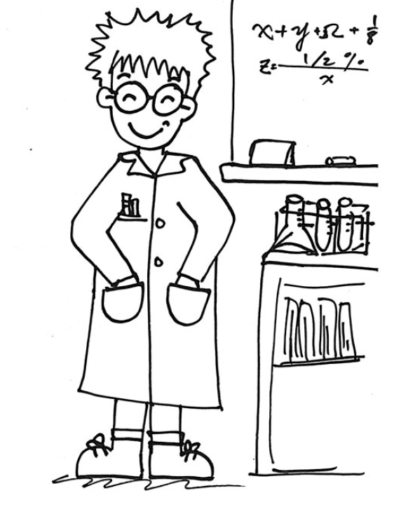
Students’ views of scientists in the literature
Stereotypical views:
predominantly male
surrounded by lab equipment
start developing at a young age and become more prevalent as children get older
Only a handful of 10-14 year olds aspire to be scientists
(Archer, 2013; Ruiz-Mallén & Escalas, 2012)

Slide 3
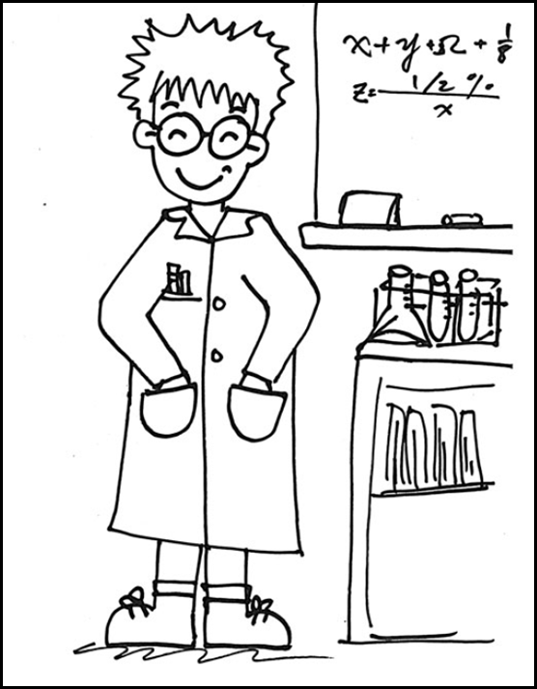
Scientist-student interactions
Can have a positive impact on students’ attitudes towards science and scientists and on development of conceptual knowledge (e.g. Gibson & Chase, 2002; Knox, Moynihan & Markowitz, 2003)
but
This evidence is mainly based on summer school evaluations or studies where scientists take on the role of the teacher

Slide 4
30% scientists have engaged in public engagement within schools
73% scientists have never had any training in public engagement
The Royal Society (2006)

Slide 5
Aims of Meet the Scientist
What is the value of short informal discussions between scientists and teenage students – for the students and for the scientists?

Slide 6
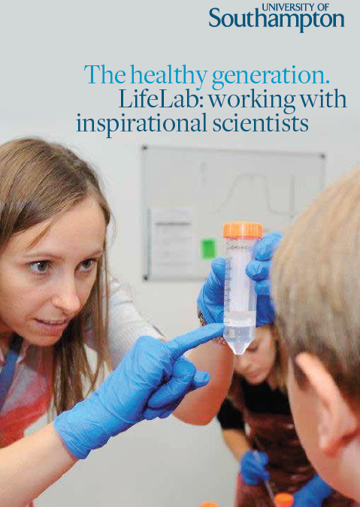
The intervention
Pre and post questionnaires for students and scientists
As part of LifeLab programme students have 2 x 15 minute
‘Meet the Scientist’ sessions
49 sessions were audio recorded
Small groups of 7-8 students
Scientists’ brief:
to talk about themselves, their work, how they got into their science discipline and let students ask them questions

Slide 7
The intervention
Students were given the opportunity to interact with scientists beyond the one-way transmission model (frequently perceived by scientists as the norm in science communication events) Bray, France & Gilbert (2012)

Slide 8
Participants
223 students
20 scientists
43 Year 8 (12-13 years old)
180 Year 9 (13-14 years old)
from 4 local state schools
Variety involved from:
  Cancer research
  Heart disease
  Nutrition
  Placenta
  Bioengineering
  Genetics
  Asthma research
  Bone and joint research

Slide 9
Methods
Student questionnaires

Slide 10
Value to the Students

Slide 11
What kind of people are scientists?
Notes:
The most frequently used words to describe a scientist

Slide 12
What (if anything) surprised you about the scientists you met?

Slide 13
A summary of students’ questions during the discussion sessions
Type of question | Example | %
Science information | ‘What is stem cell research?’ | 83
How science works | ‘How long does it take to answer a question like that?’ | 7
Citizen questions | ‘What is your opinion on animal testing?’ | 5
Personal questions | ‘Do you enjoy being a scientist?’ | 5
Notes:
focused mainly on conceptual and procedural information

Slide 14
Unanimous positive feedback from students (and their teachers) about ‘Meet the Scientist’
‘Being able to meet and talk to scientists helped them understand how science really works and this led them to consider careers they were not previously aware of or had ruled out.’ (Assistant Headteacher)

Slide 15
Value to the Scientists

Slide 16
Successful strategies for engaging students in the discussion sessions
Strategies | Number of sessions (%) | Number of scientists
use of analogies, metaphors or examples | 39 (80) | 19
elicitation of students’ knowledge of a concept | 35 (71) | 14
encouraging students to ask questions | 30 (61) | 15
introduction through questioning (Does anyone have asthma? ) | 18 (36) | 11
Notes:
Some scientists brought in materials (e.g. images, videos, posters, microscopes, ultrasound machine) that they used to describe the nature of their work.

Slide 17
Scientists’ reflections on the sessions
The genuine interest shown by the majority surprised me!!
I thought the students would be more interested in the career path to becoming a scientist and less so in the actual science.
‘… probably how nice the kids were, I thought they would be talking or something but they were generally quite interested and quite focused…’
‘…it will definitely benefit you in a way that you probably won’t realise at the time.…’
‘I found it challenging to provide an activity regarding my work that would provoke questions from the students.’
It reminded me of why I have chosen to do what I do.

Slide 18
Scientists’ reflections
focus not only on communication skills but also on how to interact with the audience
scientists became more aware of the need to engage with a range of interests and abilities
nature of interactions differed from those experienced in public engagement events
Level of questioning and range of interests emerged as the main challenges
Recommendation…professional development training for scientists…

